Slide 1

FLIGHT PRICE PREDICTION USING ML
Prepared By:
SNEHA SANTRA

Slide 2
MODELS COMPARISION
MODEL BUILDING
Thank you
EDA
Key Findings
Conclusion
Problem Overview
AGENDA

Slide 3

Problem Overview
Anyone who has booked a flight ticket knows how unexpectedly the prices vary. The cheapest available ticket on a given flight gets more & less expensive over time. This usually happens as an attempt to maximize revenue based on –
1. Time of purchase patterns (making sure last-minute purchases are expensive)
2. Keeping the flight as full as they want it (raising prices on a flight which is filling up in order to reduce sales and hold back inventory for those expensive last-minute expensive purchases)
So, you have to work on a project where you collect data of flight fares with other features and work to make a model to predict fares of flights.

Slide 4
Flight Price Prediction
Customers are seeking to get the lowest price for their ticket, while airline companies are trying to keep their overall revenue as high as possible and maximize their profit.
India is the third-biggest avionics showcase in 2020 and the biggest by 2030.
From the customer point of view, determining the minimum price or the best time to buy a ticket is the key issue. The conception of ‘‘tickets bought in advance are cheaper” is no longer working (William Groves and Maria Gini, 2013)

Slide 5
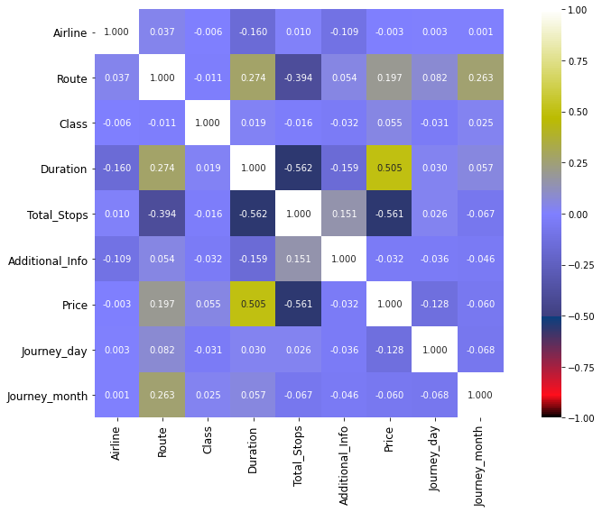
Correlation with Target Variable

Slide 6

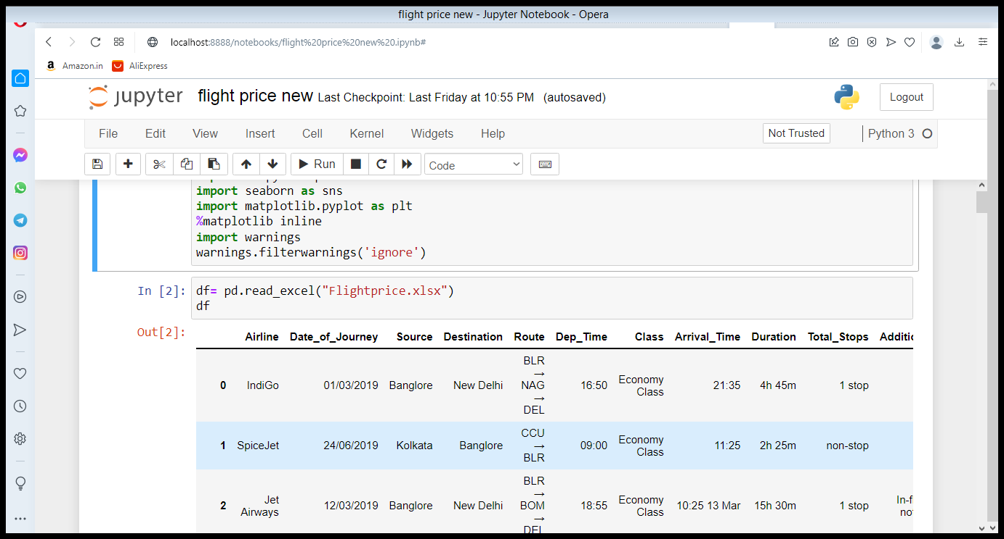



Dataset
Model Validation
Model Performance measure on
testing data
Dataset is scrapped from some website like yatra,skyscanner and it is build a excel dataset.
Dataset is flight price prediction .There are 12 columns and 1930 intities.and we are observed the flight price .
STEP
04
Model Preparation
We teach the model
on Training dataset,
STEP
03
Analytical approach
Supervised Machine Learning problem,
Two class Classification,
STEP
02
Analyse Data
Heterogeneous population, Anomaly Treatment, Missing Values Treatment, creating new variable
STEP
01

Slide 7
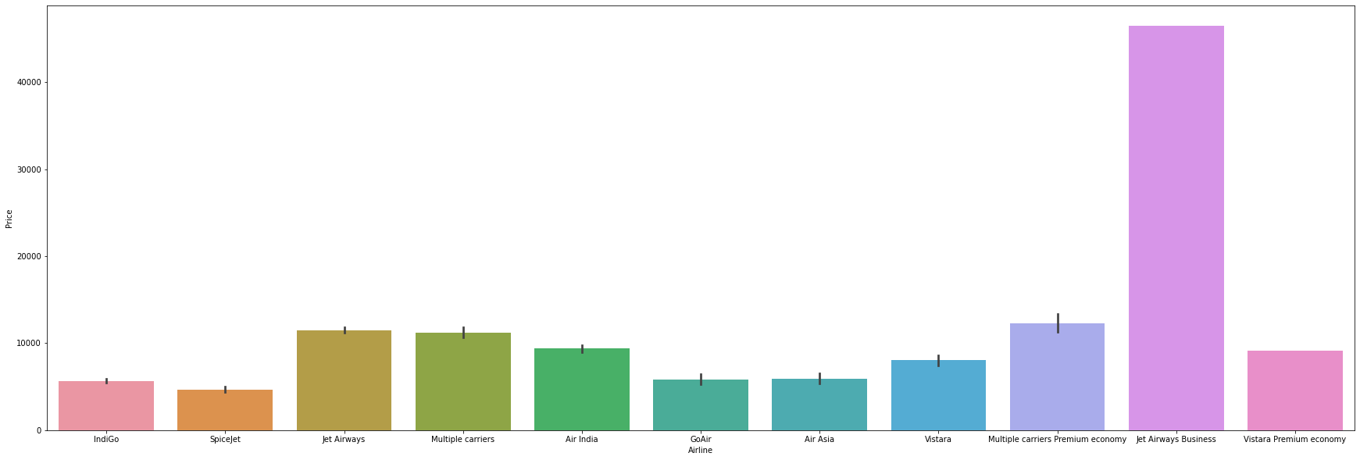
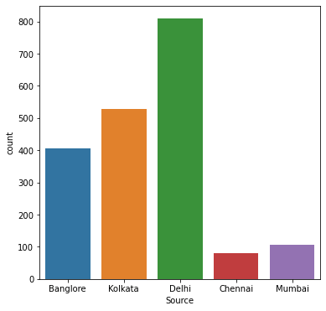
EDA
INDIGO is cheaper than jet airways

Slide 8
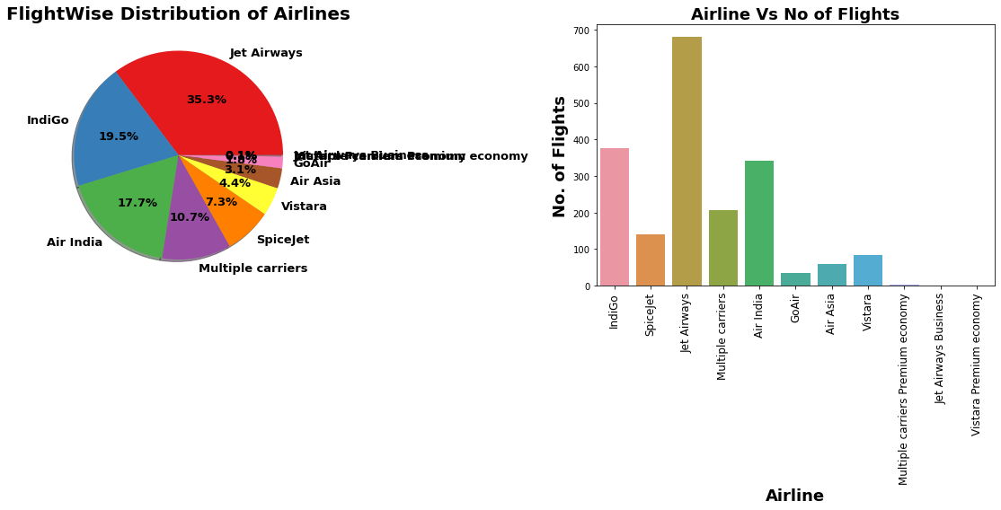
We can see maximum number of flights run by Jet Airways

Slide 9
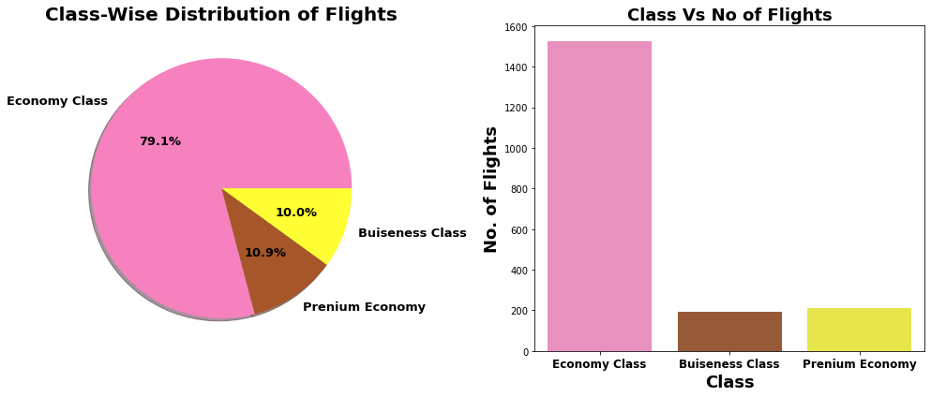
79.1% flights are of Ecomony class, as they are low cost of flight & most of people prefer it.

Slide 10
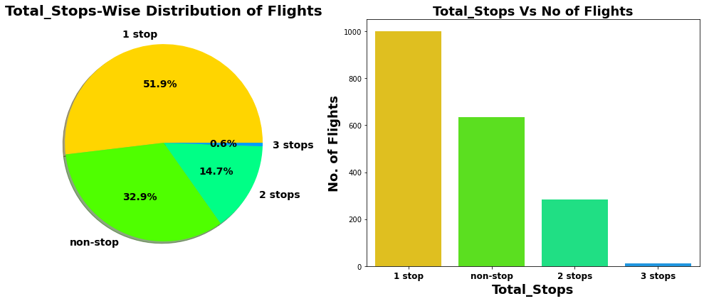
51.9% flights take single stop in there way.It is also possible that these flights may have high flight duration compare to Non-stop Flight 32.9% of flights do not have any stop in there route

Slide 11








Key Insights
The most important factors that influence the problem
Airline
Feature 8
Source
Price
Duration
Journey Day
Class
Total Stops

Slide 12
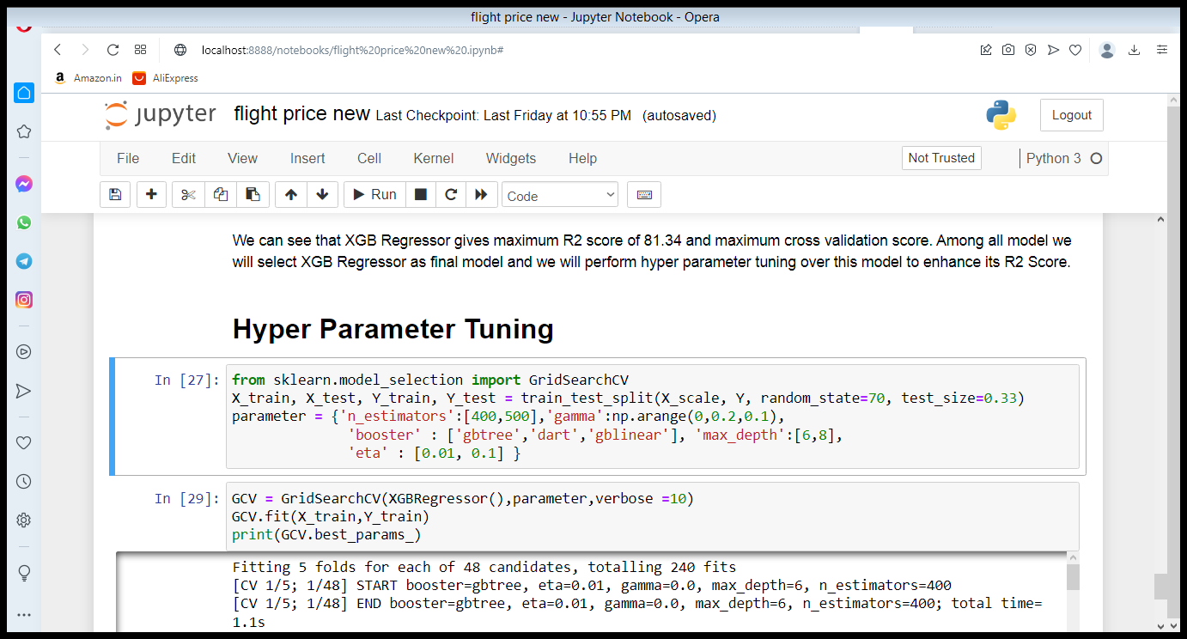
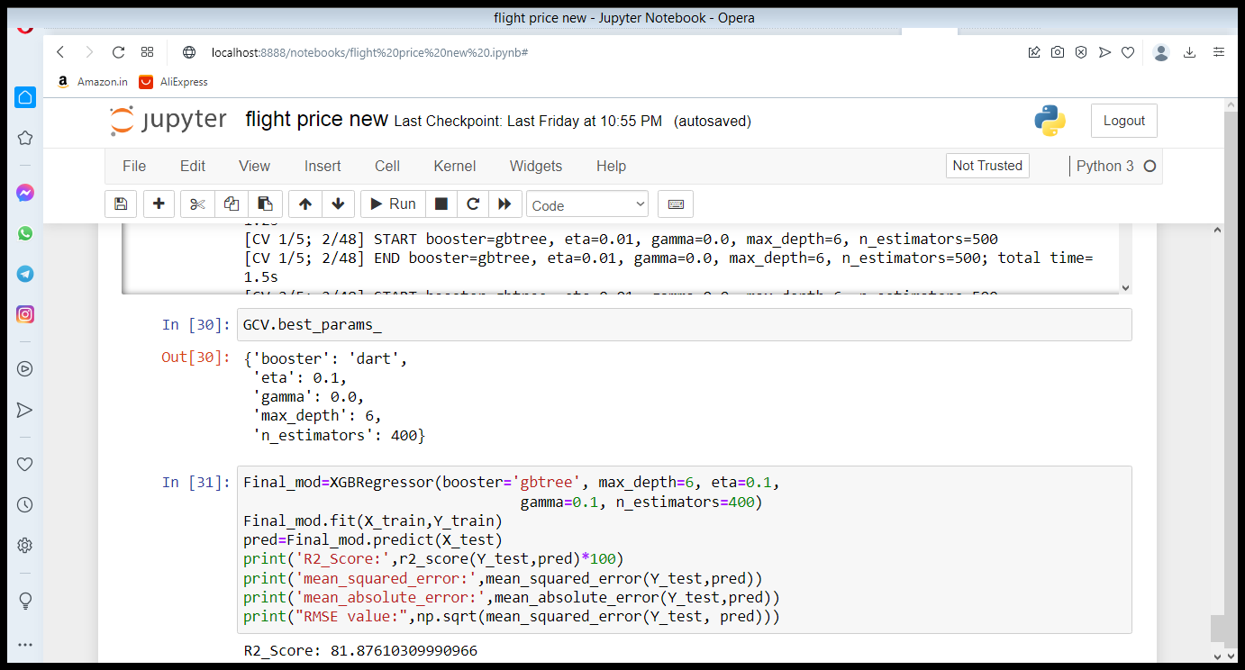
Hyper Parameter Tuning of Best Model
XGB Regressor gives maximum R2 score of 81.876 and maximum cross validation score.

Slide 13
MODEL COMPERISION
Algorithm | R2 Score | CV Score
Random Forest Regressor | 80.04 | 0.79
XGB Regressor | 81 | 0.7582
Linear Regression | 42.43 | 0.39
Decision Tree Regressor | 68.44 | 0.68

Slide 14
CONCLUSION
Key Findings and Conclusions of the Study
After the Final Submission of test data, my accuracy score was 81.87%
Feature engineering helped me increase my accuracy.
Amazingly Xgb Classifier worked better than all other Ensemble models.

Slide 15
THANK YOU

